Slide 1
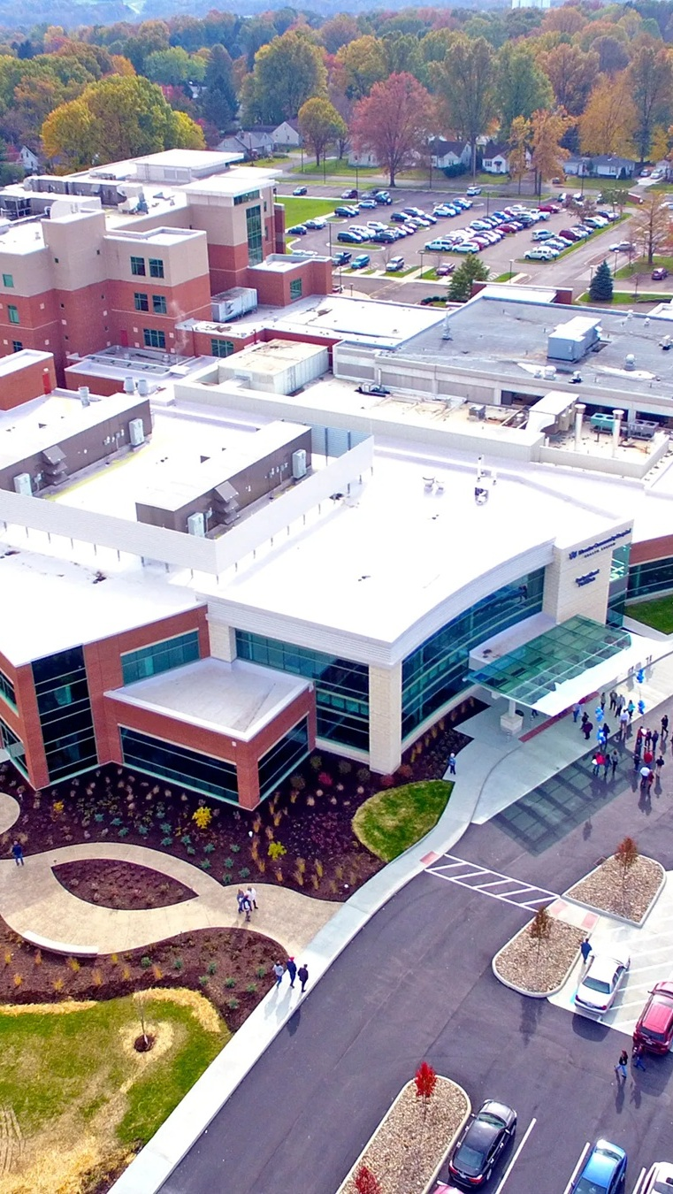


OPPORTUNITY REVIEW
DIRECT-TO-EMPLOYER GTM STRATEGY
Exploring a Wooster Community Hospital DTE Health Plan

Slide 2


Founded in 1979, headquartered in Indianapolis
Largest Independently-Owned Full-Service Third-Party Administrator
Specialize in Administration of Self-Funded Plans and Population Health Management​
Leader in the Direct-to-Employer Movement
We Know and Understand the Market
Experience Working with All Professional Teams: Agents, Networks, MGAs
The Key Family of Companies is a Vertically Integrated group of benefit related organizations
3,000+ Corporate Clients
3 Million Members under Management
700 Employees

Slide 3
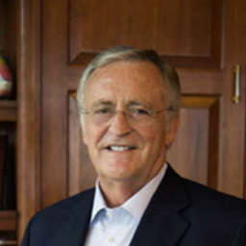


Our Founding and Heritage: 46 Years of Striving for Honesty in Healthcare

Slide 4
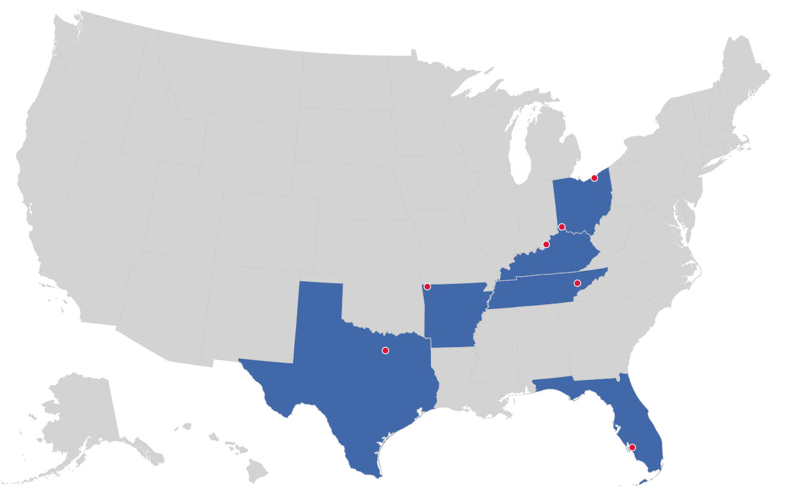

MARKET LEADER
IN
PRIVATE LABELED
DTE PLANS
Cleveland, OH
Louisville, KY
Cincinnati, OH
Bentonville, AR
Knoxville, TN
Dallas Fort Worth, TX
Fort Myers, FL

Slide 5


DIRECT-TO-EMPLOYER (DTE)
YOU Pick the Name of the Health Plan
YOU Determine the Fees Charged
YOU Practice the Medicine
YOU Receive the Profits
WE Make it Successful
Your Health Plan Focused on a Direct Relationship with Self-Funded Employers in Your Market

Slide 6
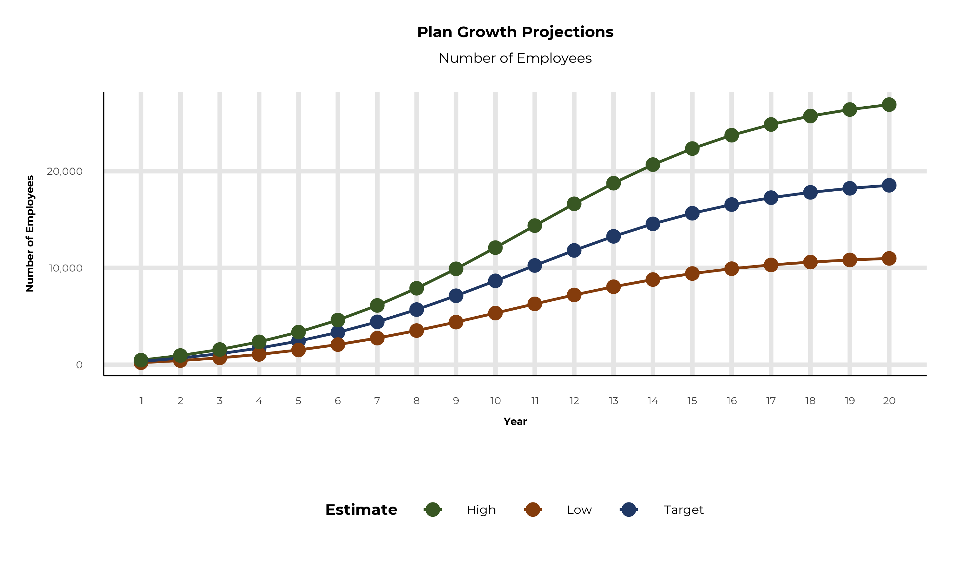
PLAN POTENTIAL GROWTH PATHS
Self Funded
127K
Insured
182K
Working Age
255K
Population
447K
Estimates includes the Wooster Community Hospital service area in Ashland, Holmes, Medina, Stark, Summit, and Wayne Counties

Slide 7
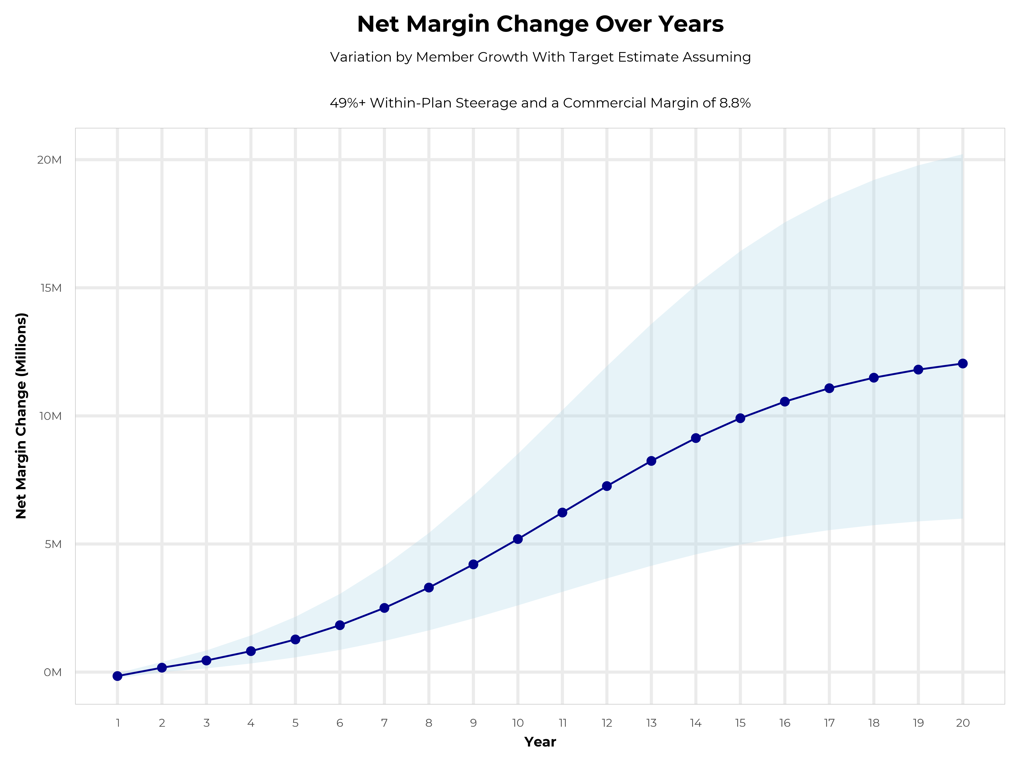
GROWING POWERFUL, LASTING PROFITABILITY
Early Stage
Gaining Name Recognition, Early Growth
New Revenue:
New Profit:
$10.21M
$0.73M
Growth Stage
Strong Reputation, Strong Growth
New Revenue:
New Profit:
$59.61M
$5.28M
Mature Stage
High Profitability, Market Saturation
New Revenue:
New Profit:
$120.84M
$10.86M

Slide 8
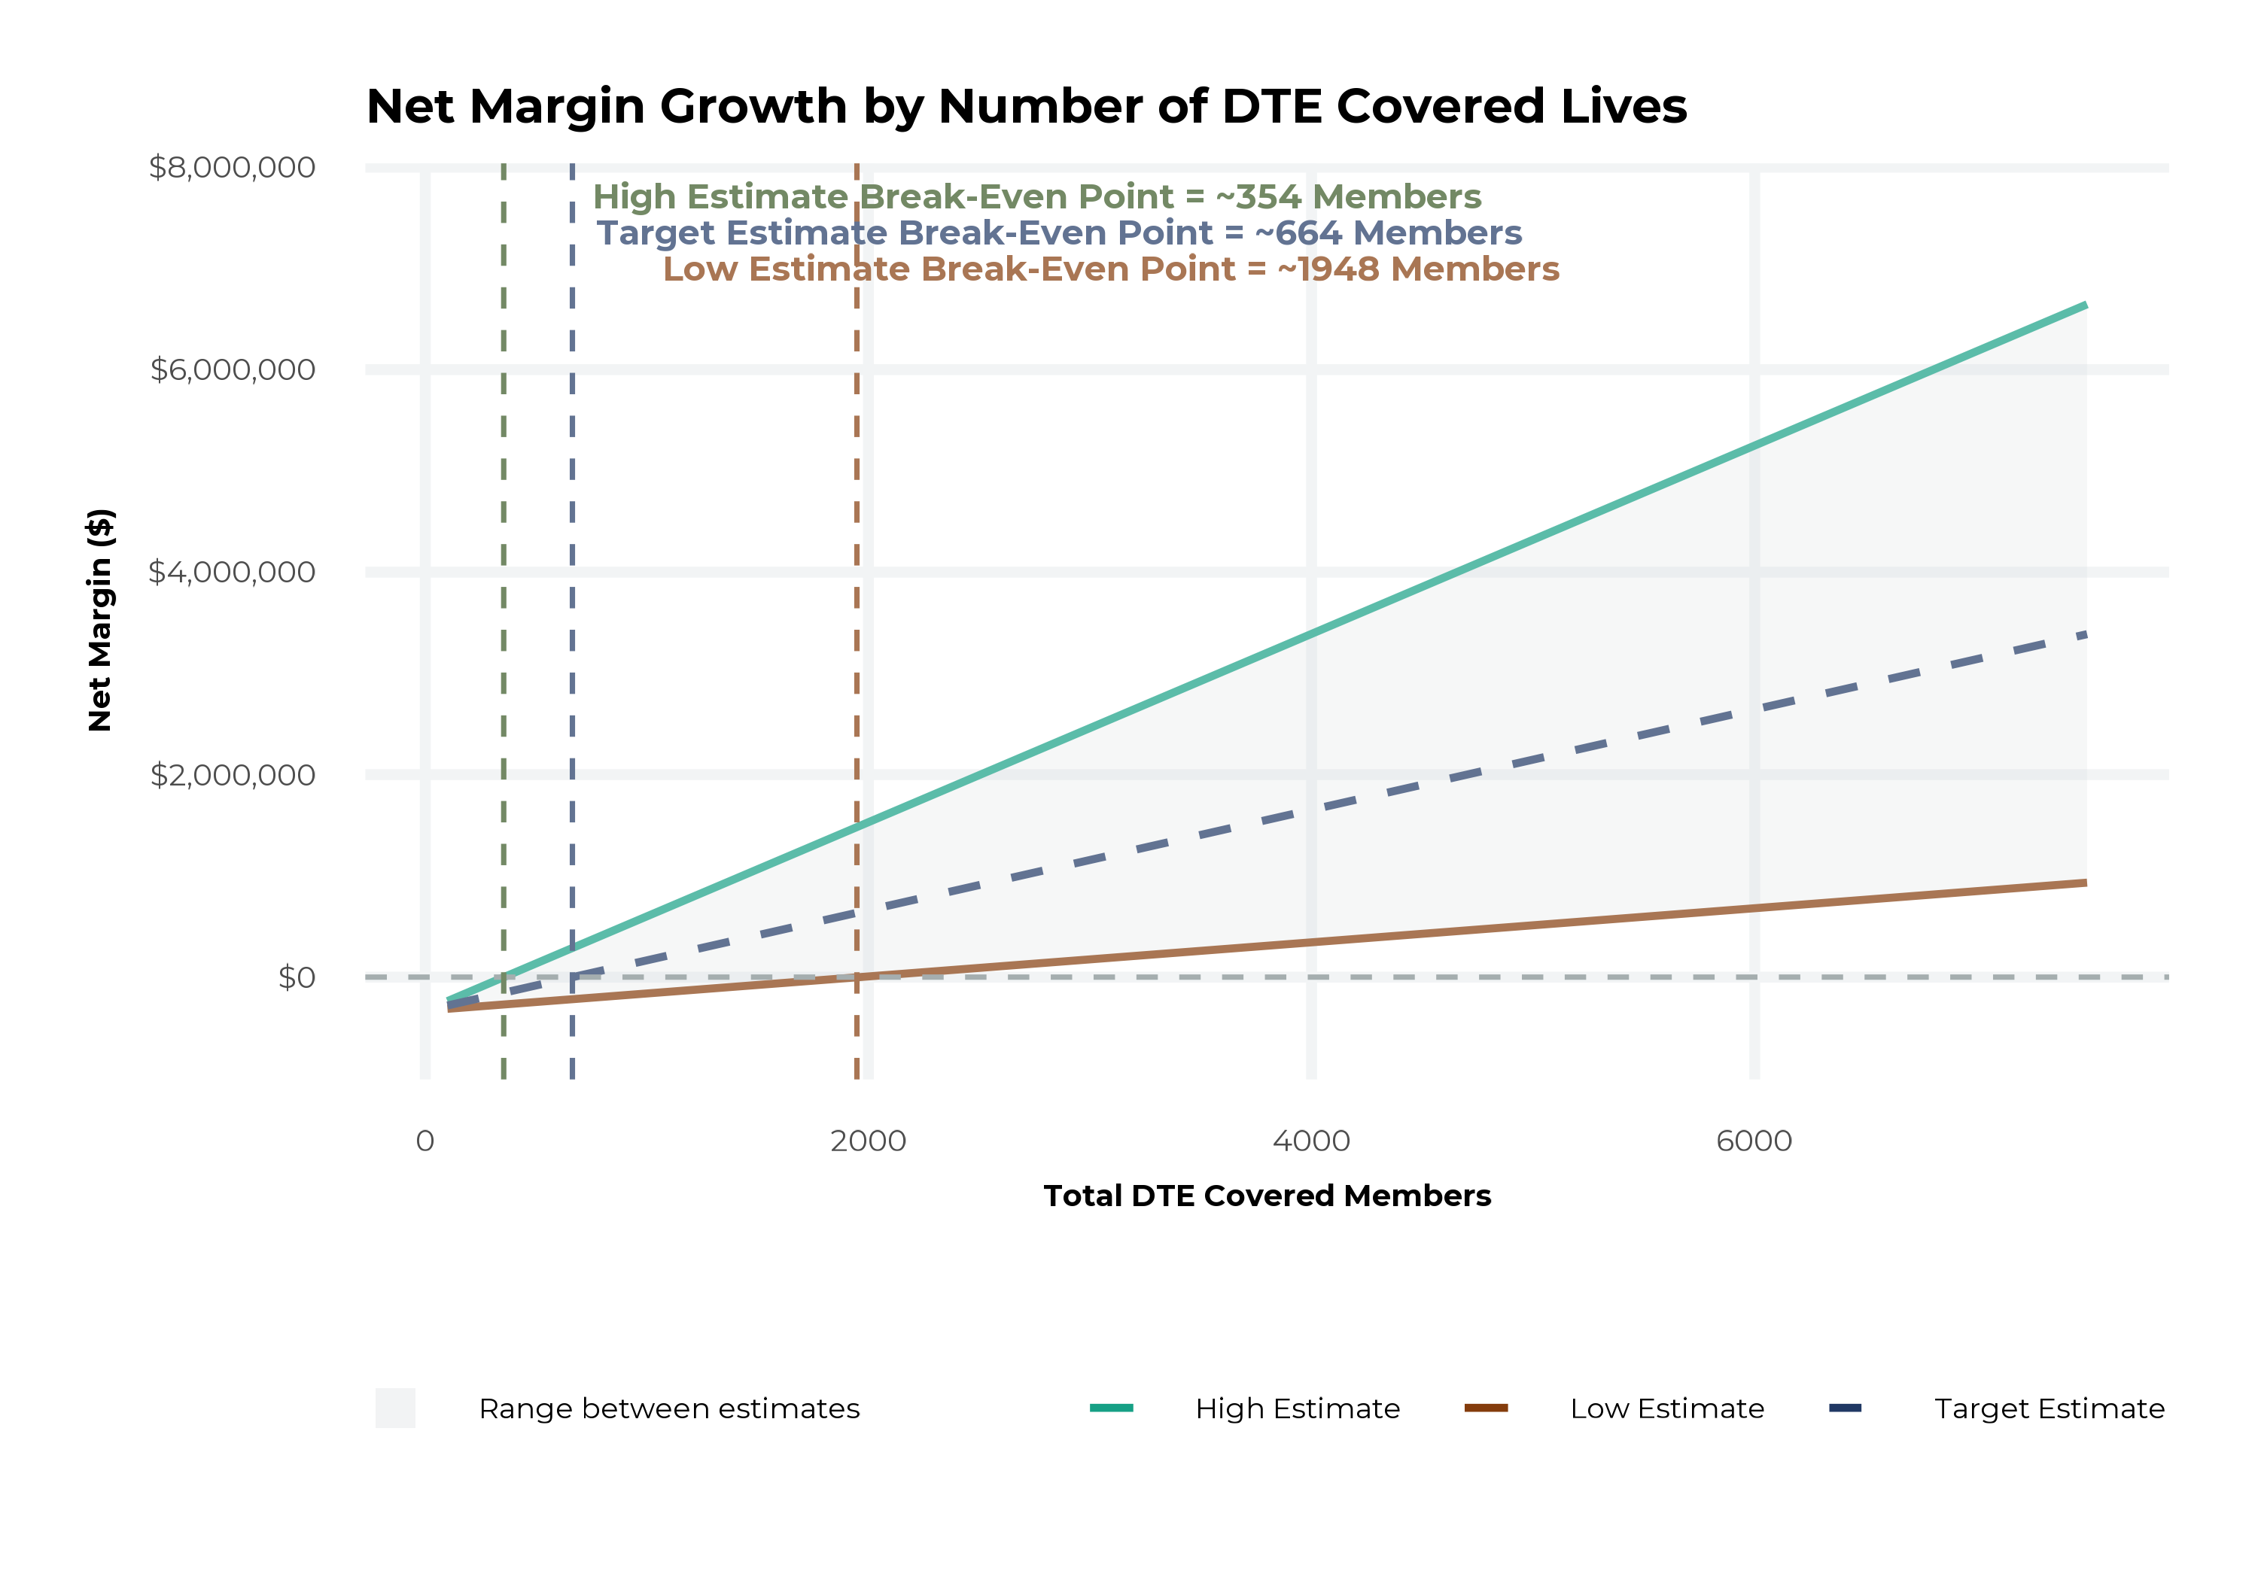
MODEL ASSUMPTIONS AND BREAK EVEN
Patient Steerage Assumptions
KBA currently estimates that Wooster Community Hospital has 2% inpatient market share, and 2% outpatient market compared to hospitals/clinics in the Wooster Community Hospital service area (see slide 8). The DTE tiered structure will create immediate steerage, with additional steerage over time from patient bonus benefits and the patient convenience card (see slide 34 for estimates of target steerage).
Low
High
10% below target
10% above target
Commercial Margin Assumptions
KBA observes a Wooster Community Hospital 11% commercial margin. Conservatively, we model the DTE to be even with commercial rates given prices 10% below market, but with a 10 percentage-point increase through friendlier billing practices and improved patient collections with the patient card.
Low
Target
High
3.8%
8.8%
13.8%

Slide 9
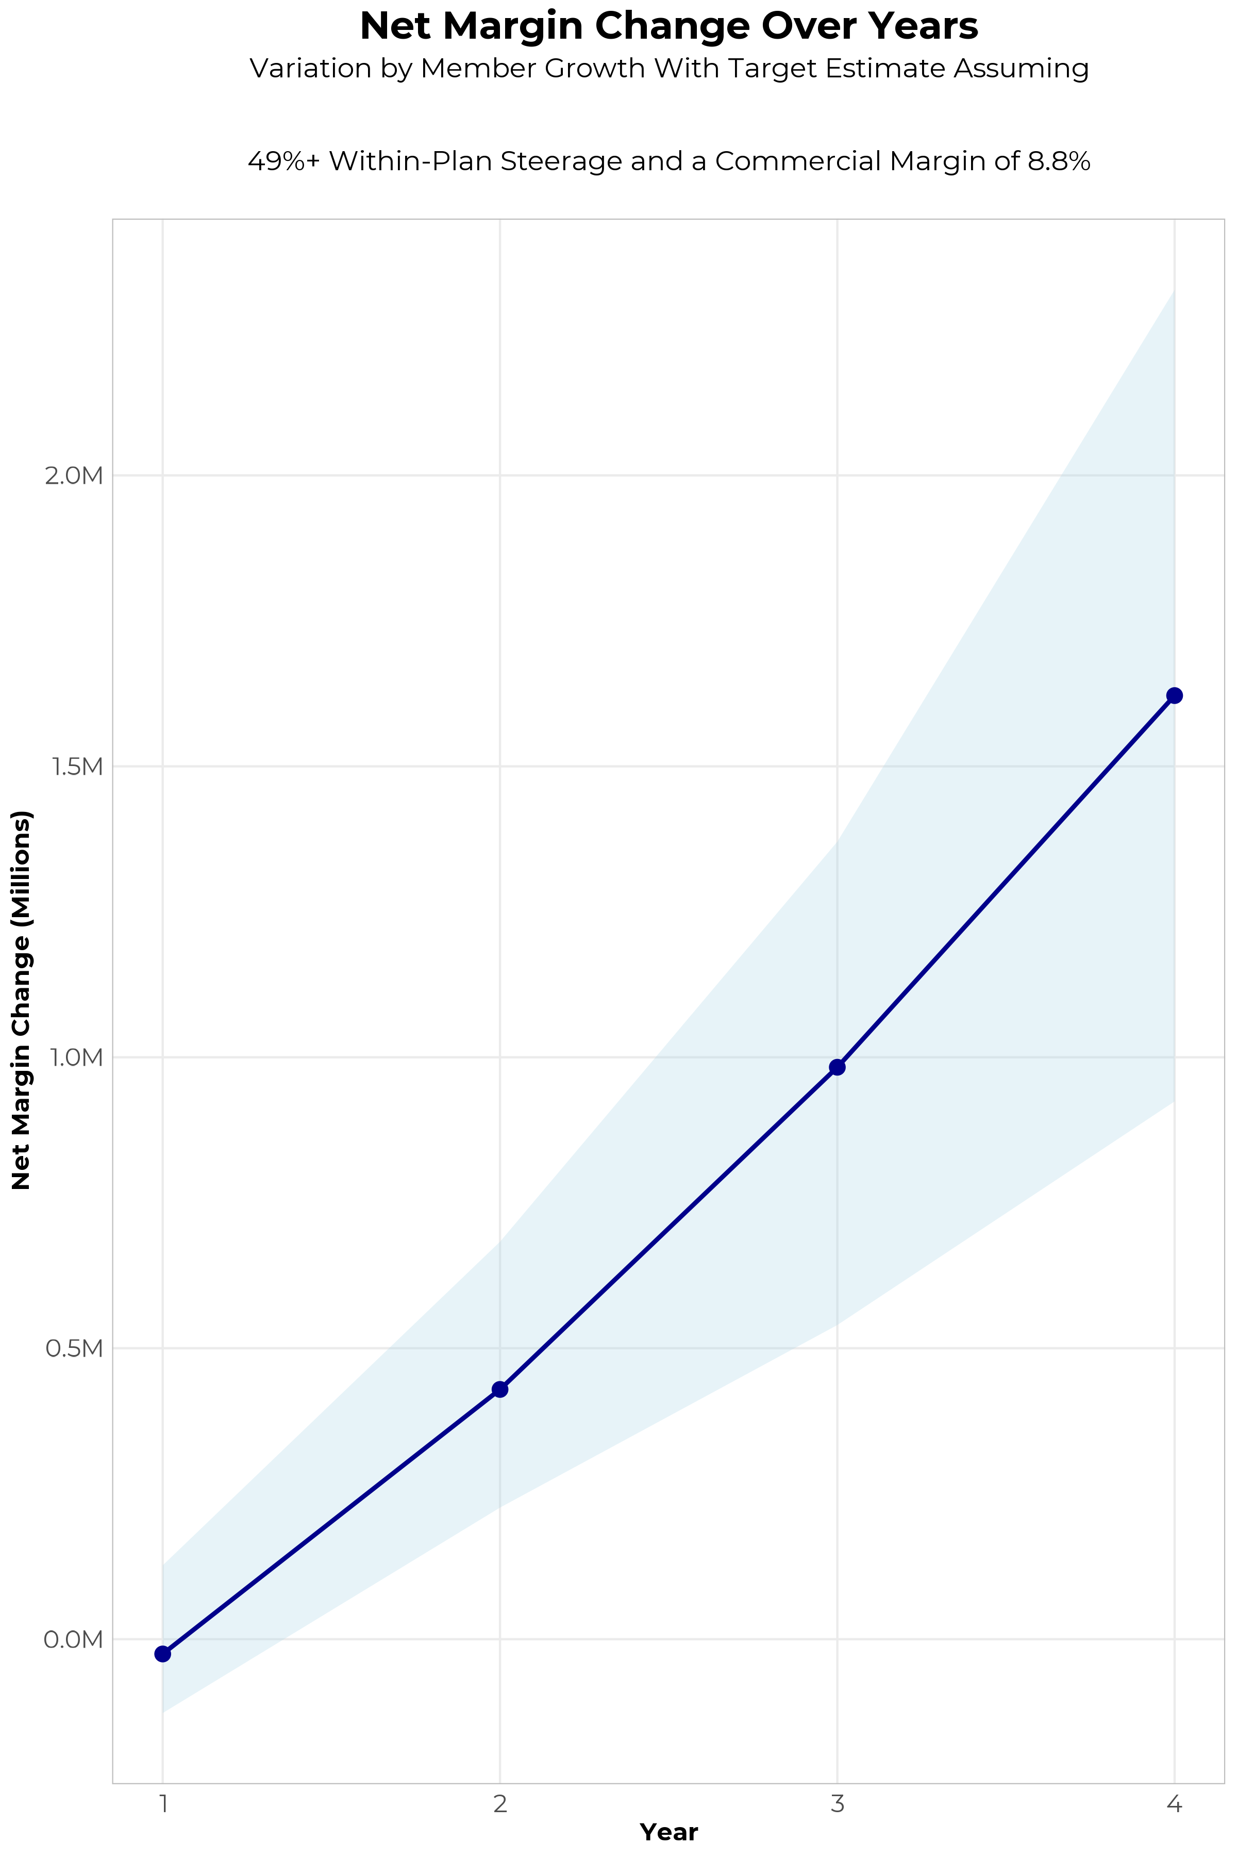
FOUR-YEAR PROJECTIONS
Target Member Growth | Target Member Growth | Target Member Growth | Target Member Growth | Target Member Growth
Metric | Year 1 | Year 2 | Year 3 | Year 4
Number of Members | 600 | 1,200 | 2,100 | 3,100
Incremental Margin | 297.4K | 594.8K | 1,137.6K | 1,764.4K
Network Access Fee | 7.2K | 14.4K | 25.2K | 37.2K
Implementation Fee (One-Time) | -150.0K | 0.0K | 0.0K | 0.0K
Sales and Marketing Costs | -180.0K | -180.0K | -180.0K | -180.0K
Net Margin Change | -25.4K | 429.2K | 982.8K | 1,621.6K
High Member Growth | High Member Growth | High Member Growth | High Member Growth | High Member Growth
Metric | Year 1 | Year 2 | Year 3 | Year 4
Number of Members | 900 | 1,700 | 2,800 | 4,300
Incremental Margin | 446.1K | 842.6K | 1,516.9K | 2,447.4K
Network Access Fee | 10.8K | 20.4K | 33.6K | 51.6K
Implementation Fee (One-Time) | -150.0K | 0.0K | 0.0K | 0.0K
Sales and Marketing Costs | -180.0K | -180.0K | -180.0K | -180.0K
Net Margin Change | 126.9K | 683.0K | 1,370.5K | 2,319.0K
Low Member Growth | Low Member Growth | Low Member Growth | Low Member Growth | Low Member Growth
Metric | Year 1 | Year 2 | Year 3 | Year 4
Number of Members | 400 | 800 | 1,300 | 1,900
Incremental Margin | 198.3K | 396.5K | 704.3K | 1,081.4K
Network Access Fee | 4.8K | 9.6K | 15.6K | 22.8K
Implementation Fee (One-Time) | -150.0K | 0.0K | 0.0K | 0.0K
Sales and Marketing Costs | -180.0K | -180.0K | -180.0K | -180.0K
Net Margin Change | -126.9K | 226.1K | 539.9K | 924.2K

Slide 10

THE BENEFIT STEERING THE PATIENT TO WOOSTER COMMUNITY HOSPITAL
What Will this Claim Cost Me?
Explanation of Benefits
Heart Attack, Cardiac Surgery
THE CHARGES
Medical Bills | $25,000
Healthcare out-of-pocket due to provider | $4,500
Since your out of pocket maximum has been met, the rest of your eligible charges this year will be paid at 100%
THE CREDITS
OP Radiology/X-Ray | $200
OP Diagnostic Labs | $100
Preferred Hospital Stay ($500/day, 5 days) | $2,500
Critical Illness Benefit | $2,000
Health Screening Benefit | $125
Benefit Total | $4,925
Out of Pocket Paid to Hospital | ($4,500)
Balance Paid to HGA | $425
Wooster Community Hospital patients can have all out-of-pocket liability reduced to $0!

Slide 11
PROJECTED PLAN GROWTH
Year | Employees | Members | Percent of Members Choosing Wooster Community Hospital for Inpatient Care | Percent of Members Choosing Wooster Community Hospital for Outpatient Care
1 | 300 | 500 | 60% | 50%
2 | 700 | 1,300 | 60% | 50%
3 | 1,100 | 2,000 | 65% | 55%
4 | 1,700 | 3,100 | 67% | 58%
5 | 2,400 | 4,300 | 68% | 60%
6 | 3,300 | 5,900 | 68% | 60%
7 | 4,400 | 7,900 | 69% | 61%
8 | 5,700 | 10,300 | 69% | 62%
9 | 7,100 | 12,800 | 69% | 62%
10 | 8,700 | 15,700 | 70% | 63%
11 | 10,300 | 18,500 | 70% | 63%
12 | 11,800 | 21,200 | 70% | 64%
13 | 13,300 | 23,900 | 71% | 64%
14 | 14,600 | 26,300 | 71% | 65%
15 | 15,600 | 28,100 | 71% | 66%
16 | 16,500 | 29,700 | 72% | 66%
17 | 17,300 | 31,100 | 72% | 66%
18 | 17,800 | 32,000 | 72% | 67%
19 | 18,200 | 32,800 | 72% | 67%
20 | 18,500 | 33,300 | 72% | 67%
KBA currently estimates that Wooster Community Hospital has 2% inpatient market share, and 2% outpatient market compared to hospitals/clinics in the Wooster Community Hospital service area (see slide 8).
Based on previous DTE experience, KBA expects a significant bump in patient steerage to Wooster Community Hospital.
Additional steerage will occur from additional steerage patient benefits and the patient convenience card.
High estimates start nearly 10% higher than target with low estimates at 10% lower than target

Slide 12
YEAR 4 PROJECTED REVENUE AND PROFIT
Pre-DTE Cohort of 3,100 Employees | Inpatient | Outpatient | Professional | Total
Revenue† | $ 199,676.4 | $ 345,636 | $ 161,409.1 | $ 706,721.5
Net Income‡ | $ 17,571.52 | $ 30,415.97 | $ 14,204 | $ 62,191.49
† Assuming proportional revenues from market shares of 2% (inpatient) and 2% (outpatient)
‡ Conservatively assuming a commercial margin of 8.8% (80% of the estimated commercial margin)
With DTE | Inpatient | Outpatient | Professional | Total
Revenue⁰ | $ 6,158,301 | $ 9,663,034 | $ 4,512,555 | $ 20,333,890
Net Income* | $ 541,930.5 | $ 850,347 | $ 397,104.8 | $ 1,789,382
⁰ Assuming 67% inpatient and 58% market steerage based on KBA narrow network DTE experience (see previous slide)
* Conservatively assuming a commercial margin of 8.8%, with a 10 percentage-point reduction to reflect competitive-edge rates and a 10 percentage-point increase due to lower billing costs and higher patient responsibility collections because of the member convenience card.
Total Increase in Net Income | $ 1,727,191
Network Access Fee (Revenue) of $1 PMPM | $ 37,200
Total Profit Growth | $ 1,764,391
Minus Implementation Fee (One-Time) | -$ 0
Minus Sales and Marketing (Annual – Ongoing) | -$ 180,000
Total | $ 1,584,391

Slide 13

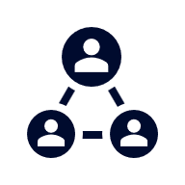



A PARTNER YOU CAN TRUST
OUR OBJECTIVES ARE ALIGNED
WE KNOW THE
MARKET
COMPLETELY TRANSPARENT
WE HAVE THE SOPHISTICATION AND INFRASTRUCTURE TO EFFECTIVELY COMPETE
Derek Moore, Senior Vice President – KBA
845-283-9973 * derek.moore@keybenefit.com

